Slide 1
LECTURE 11
TOEIC SPEAKING
Questions 4-5-6

Slide 2
    I. Respond to Quesstions
You will answer three questions.
You will have 3 seconds per question to prepare your response.
Questions 4 and 5: You will have 15 seconds to respond
Question 6: You will have 30 seconds to respond

Slide 3
Example 1: Imagine that a Canadian marketing firm is doing research in your country. You have agreed to participate in a telephone interview about television viewing
Question 4: (15 seconds to respond): How often do you watch television?
Question 5: (15 seconds to respond): What kind of programs do you usually watch?
Question 6: (30 seconds to respond): Describe your favorite television program

Slide 4
    II. Structuring your responds

Slide 5
Sample Question: What’s your favorite place to buy clothing?
Sample Response: My favorite place to buy clothing is Del’s Department Store. I like it because the prices are good and the selection is nice. Last year, I got a new winter coat for only $30. I also like it because the clerks there are very friendly. They always say hello and are really helpful.

Slide 7

Sample question
You should say:
Where it is? (Nhà hàng đó ở đâu?);
What does it look like inside and outside? (Hình dáng bên ngoài và bên trong của nó như thế nào?);
What kinds of food do they serve and explain what makes this restaurant so special to you? (Nhà hàng đó phục vụ thức ăn gì và giải thích điều gì khiến cho nhà hàng đó đặc biệt với bạn và với những người khác?).

Slide 8
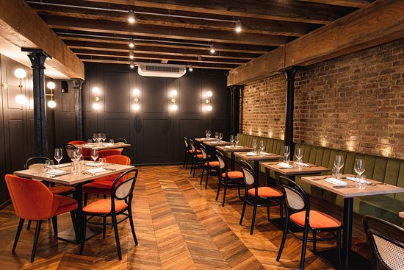
Describe your favorite restaurant
Where it is?
Thank you very much for giving me the chance to talk about my favorite restaurant. The name of my favorite restaurant is (say the name of the restaurant you are going to talk about) and it’s situated in the center of the city I am currently living in. (Hanoi)

Slide 9
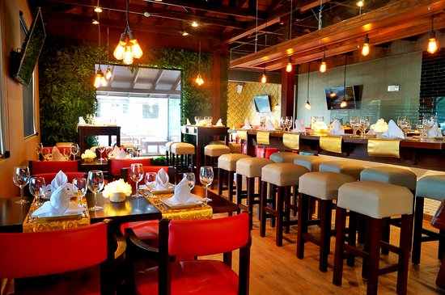
Describe your favorite restaurant
What does it look like inside and outside?
The restaurant has 3 floors and the seating arrangement is quite nice. Paintings of famous artists have been hanging on the walls and the place is quite neat and clean. The interior decoration has a charming and gorgeous feeling.

Slide 10
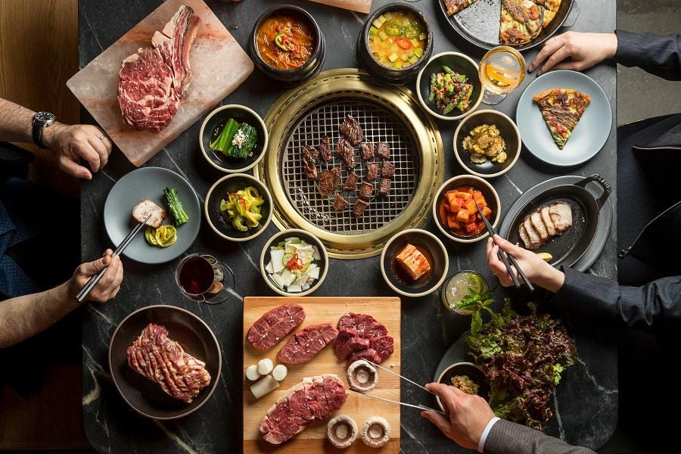
Describe your favorite restaurant
What kinds of foods do they serve and explain what makes this restaurant so special to you and others?
The restaurant offers several dishes including exotic desserts, ice-creams and also offers a separate place for the kids to play and have fun.
The prices are reasonable and the foods are served quickly as opposed to some other restaurants where you will have to wait for a long time for your food to appear on your table

Slide 11
Other sample
Sample Question: Describe your favorite restaurant
Sample Response: My favorite restaurant is really cozy and nice. It’s in an old building, so the atmosphere is really “old-style”. The walls are made of brick, and the restaurant is lit with candles. The restaurant serves excellent Italian food. The lasagna is my favorite.

Slide 12
    III. Tips and Tasks for Answering Correctly

Slide 15
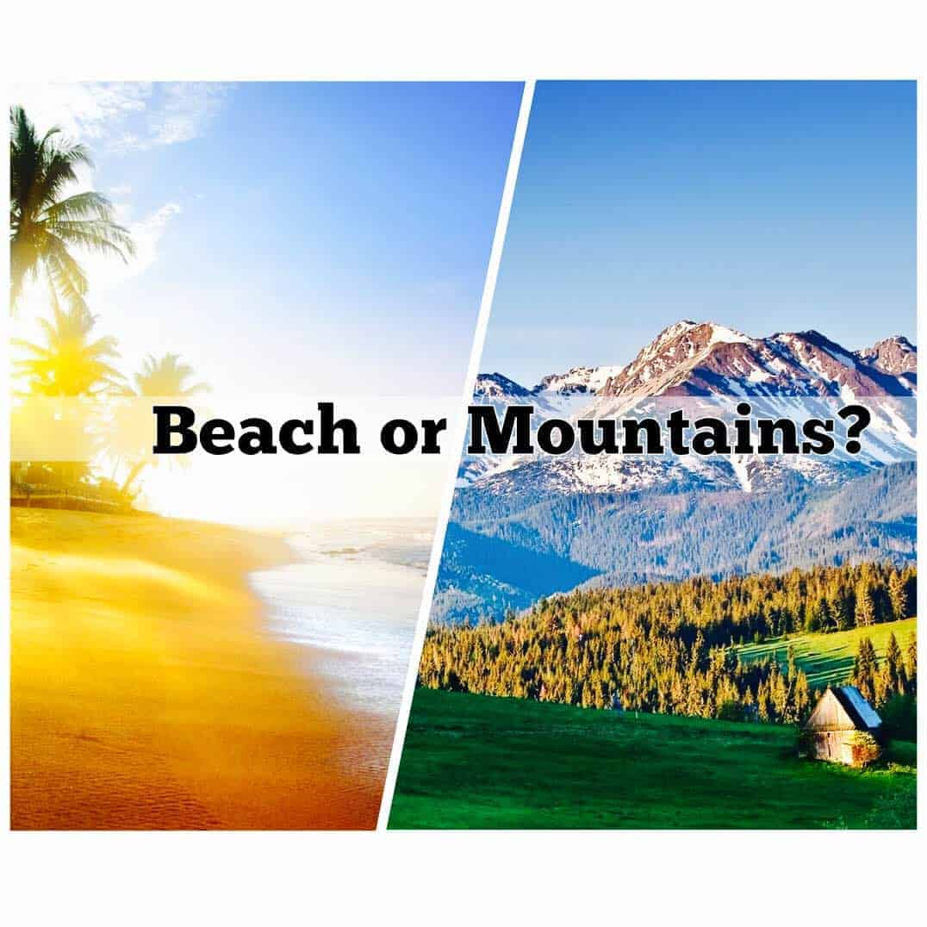
Sample answer: What is your favorite place to go on vacation?
Structures:
It is famous/renowned/noted for…: Nơi này nổi tiếng vì…
It is located/situated in…: Nơi này nằm ở…
I come here whenever I need to unwind/blow off some steam (relax): Tôi đến đây mỗi khi cần thư giãn, xả stress.
What impresses/delights me the most is…: Điều gây ấn tượng với tôi/ làm tôi vui nhất là …

Slide 16
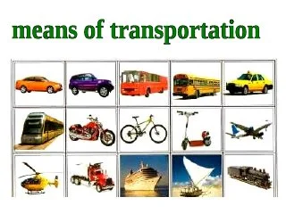
1. What is your preferred method of transportation?
My preferred method of transportation is…
You should say:
what is it
when and how often you use it
why you use it

Slide 17
HOMEWORK
Progress practice: page 40

